Slide 1



WELCOME
to the
FUTURE
of REAL ESTATE

Slide 2
These figures are not a guarantee, representation or projection of earnings or profits you can or should expect. They also do not include expenses incurred by agents in operating their businesses. eXp Realty makes no guarantee of financial success.
Success with eXp Realty results only from successful sales efforts, which require hard work, diligence, skill, persistence, competence, and leadership. Your success will depend upon how well you exercise these qualities.
Visit exprealty.com/income for average agent earnings and additional information about earning opportunities with eXp Realty.

Slide 3





5 Major Disruptors
CLOUD
LEAD GEN
STOCK
REVSHARE
HEALTH
Cutting Edge Cloud Base Real Estate Company
Revolutionary Lead Generation Software (Close more deals)
Agent Owned Company
(Public Stock)
Un-matched Revenue Sharing
Affordable eXp Healthcare

Slide 4







Innovation Is Always Happening
eXp Realty is innovating in the real estate brokerage space
Brick & Mortar Locations
Anytime, Anywhere, On Demand
Traditional real estate brokerages
*Trademarks pictured are the property of their respective owners

Slide 5
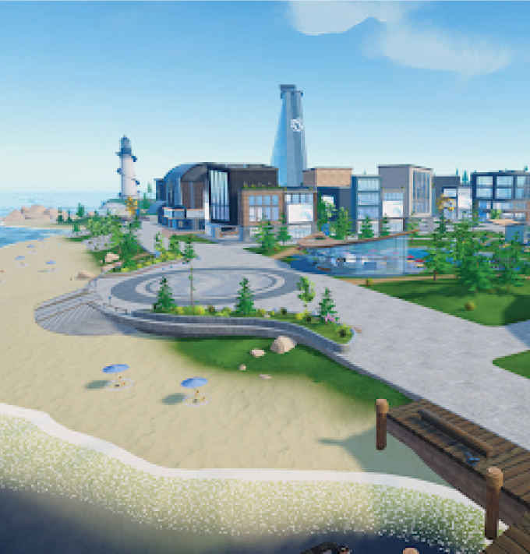
Find your freedom in eXp World,
our metaverse powered by Virbela
Work from anywhere with access to training, support and community
Access real-time support from
dedicated staff – Including Tech Support
No desk fees or overhead costs
No expensive leases means we can invest in you and your technology
One Global Brokerage across 24 Countries

Slide 6
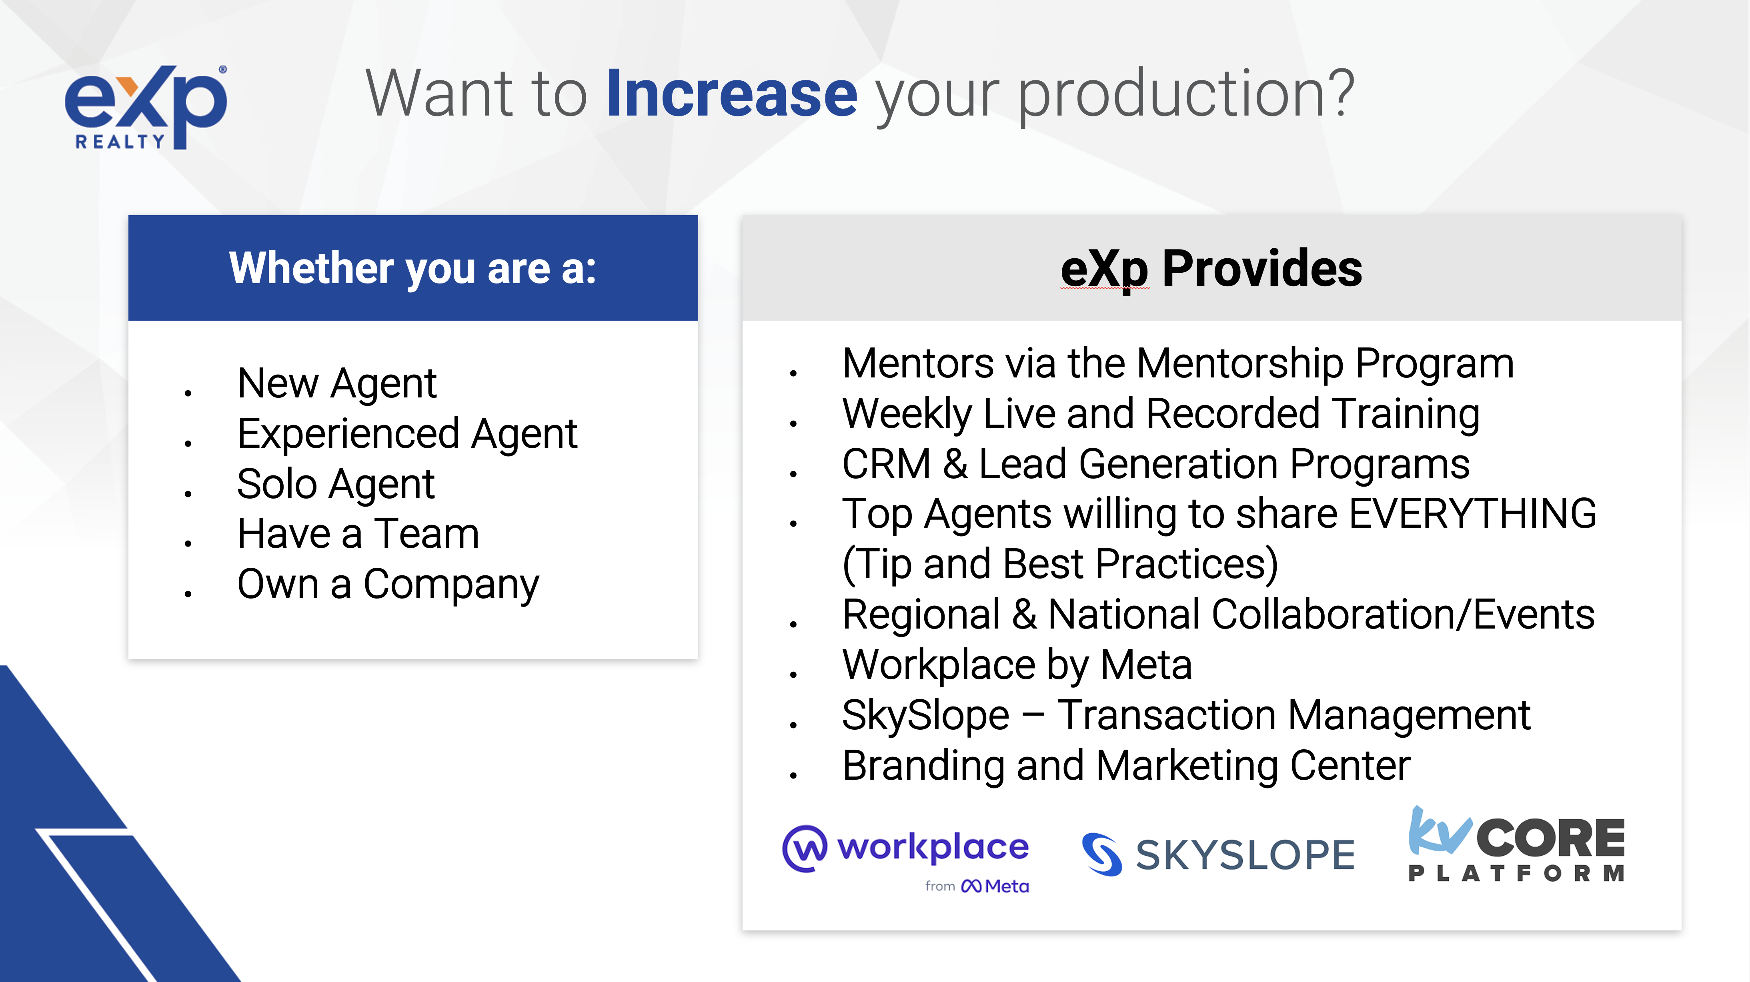

Slide 7

Live Training at your fingertips
eXp UNIVERSITY & Mentorship
More than 80+ weekly live classes taught by top-producing agents
Sales & Listings Strategies
Lead Gen Tips
Social Media Boost
Much more
Recordings of classes are available 24/7 on eXp University
Mentorship Programs are available and pairs you with experienced eXp agents

Slide 8

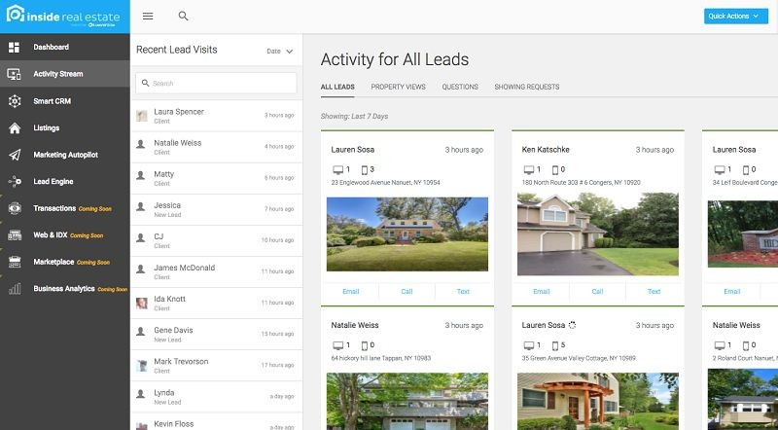
CRM & Lead Generation
Powered by KVCore
Agents and teams use tools provided by eXp Realty daily to drive more leads and deals. Manage customer interactions and share property information.
Powerful lead generation platform provided at no additional cost
Integrate listings with your own WordPress Website
Optional in-house lead generation program

Slide 9
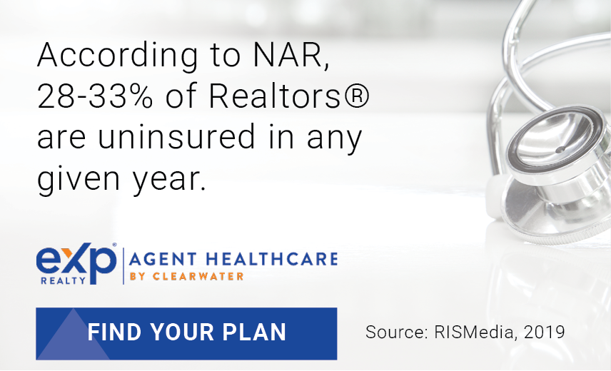
We’re proud to offer eXp Healthcare, providing our U.S. agents and
their families high-quality and affordable group health insurance
Decrease your out of pocket costs on average of up to $16,000 yearly and improve your provider network.
Our concierge service is happy to help with all of your scheduling needs.
Incredible coverage with low copays, mental health coverage and the ability to add on vision, dental,
critical Illness, and accident coverage
Affordable monthly premiums, limited out-of-pocket maximum, and $0 deductible plans available
Many plans have an Open Network that allows
for access to the best doctors in the country

Slide 10
Earn more with our competitive
commission structure.
COMMISSION & CAP
80/20 commission split $16,000 cap
After capping, earn 100% commission for the remainder of the year.¹
¹$250 capped transaction fee. Once capped transaction fees
total $5,000, the capped transaction fee is reduced to $75.
STANDARD COSTS²
$149 start-up fee
$85/month cloud brokerage fee
$25 transaction review fee³
$40 risk management fee⁴
² U.S. compensation model.
³ Per transaction.
⁴ Per transaction and caps at $500.

Slide 11
Unique Equity Opportunities
Equity Awards
Through Incentive Program
Agent Equity Commission
Program
ICON
Award
$200 of EXPI stock for
first transaction closing
$400 of EXPI stock
when agents cap
$400 of stock for directly
attracting another agent
after the agent closes
their first transaction
Voluntarily enroll to purchase 5% of commission in stock at a 10% discount
~65% of agents and brokers participate
in the program
Top agents receive up to $16,000 in stock upon the achievement of certain production and cultural goals within
their anniversary year

Slide 12
Earn revenue share for attracting new agents to eXp
Annual Revenue Share Up to per Capping Agent:
eXp RevShare %
Personally Sponsored Agents
TIER 1
$2,800 | 3.5% | Any #
eXp agents can sponsor agents to
join the company
Earn a percentage of revenue – eXp pays the revenue share, not the agent – when your sponsored agents close a transaction.
TIER 2
$3,200 | 4.0% | 5
TIER 3
$2,000 | 2.5% | 10
TIER 4
$1,200 | 1.5% | 15
TIER 5
$800 | 1.0% | 20
TIER 6
$2,000 | 2.5% | 25
TIER 7
$4,000 | 5.0% | 40
AGC = Adjusted Gross Commission Income
FLQA = Front-Line Qualifying Agent

Slide 13
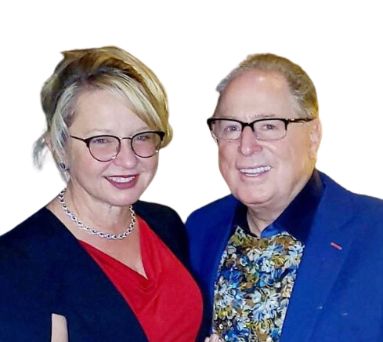
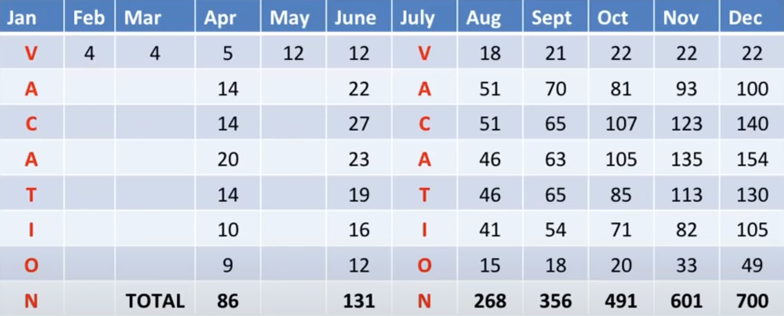
Jen & Rob Flick 2016 Snapshot
TIER 1
TIER 2
TIER 3
TIER 4
TIER 5
TIER 6
TIER 7

Slide 14




Scott 12 Months
Wilco 7 Months
Sheila 4 Months
Brent 2 Months
TIER 1
24 | 22 | 13
 | 24
TIER 2
39 | 28 | 39
 | 53
TIER 3
83 | 38 | 58
 | 29
TIER 4
82 | 17 | 31
 | 6
TIER 5
33 | 12 | 6
 | 9
TIER 6
30 | 1 | 9
 | 0
TIER 7
6 | 1 | 0
 | 0
TOTAL
297
119
156
121
Top Attractors changing lives. Who’s next?

Slide 15
